Slide 1
GM12878 Fold Enrichment
GM12878 VSS signals
K562 Fold Enrichment
K562 VSS signals

Slide 2
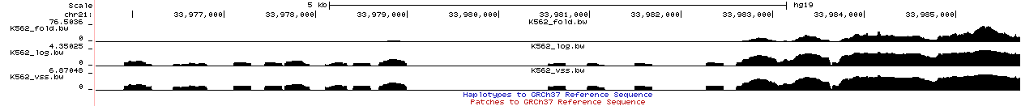
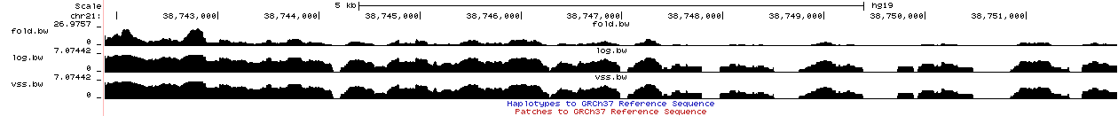
K562 Fold Enrichment
K562 log(x+1) signals
K562 VSS signals
GM12878 Fold Enrichment
GM12878 log(x+1) signals
GM12878 VSS signals

Slide 3
Bin size
Bin size
Notes:
5.parameter_setting_spline_less_than_mean_in_one_bin_version_two(selected for fold and raw) this plot is for fold enrichment

Slide 4
Bin size
Bin size
Notes:
2.parameter_setting_spline_All_scores_together(selected for pvalue)

Slide 5
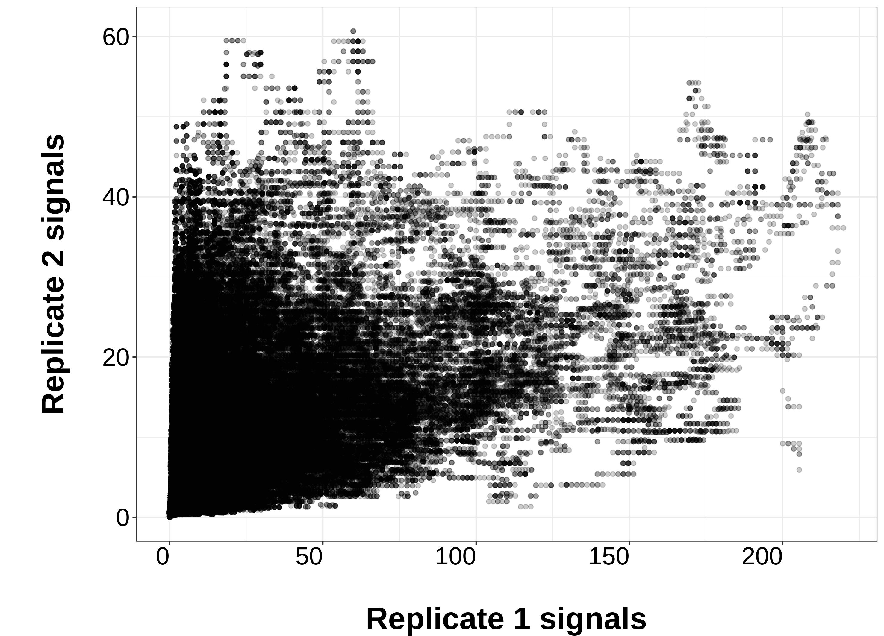
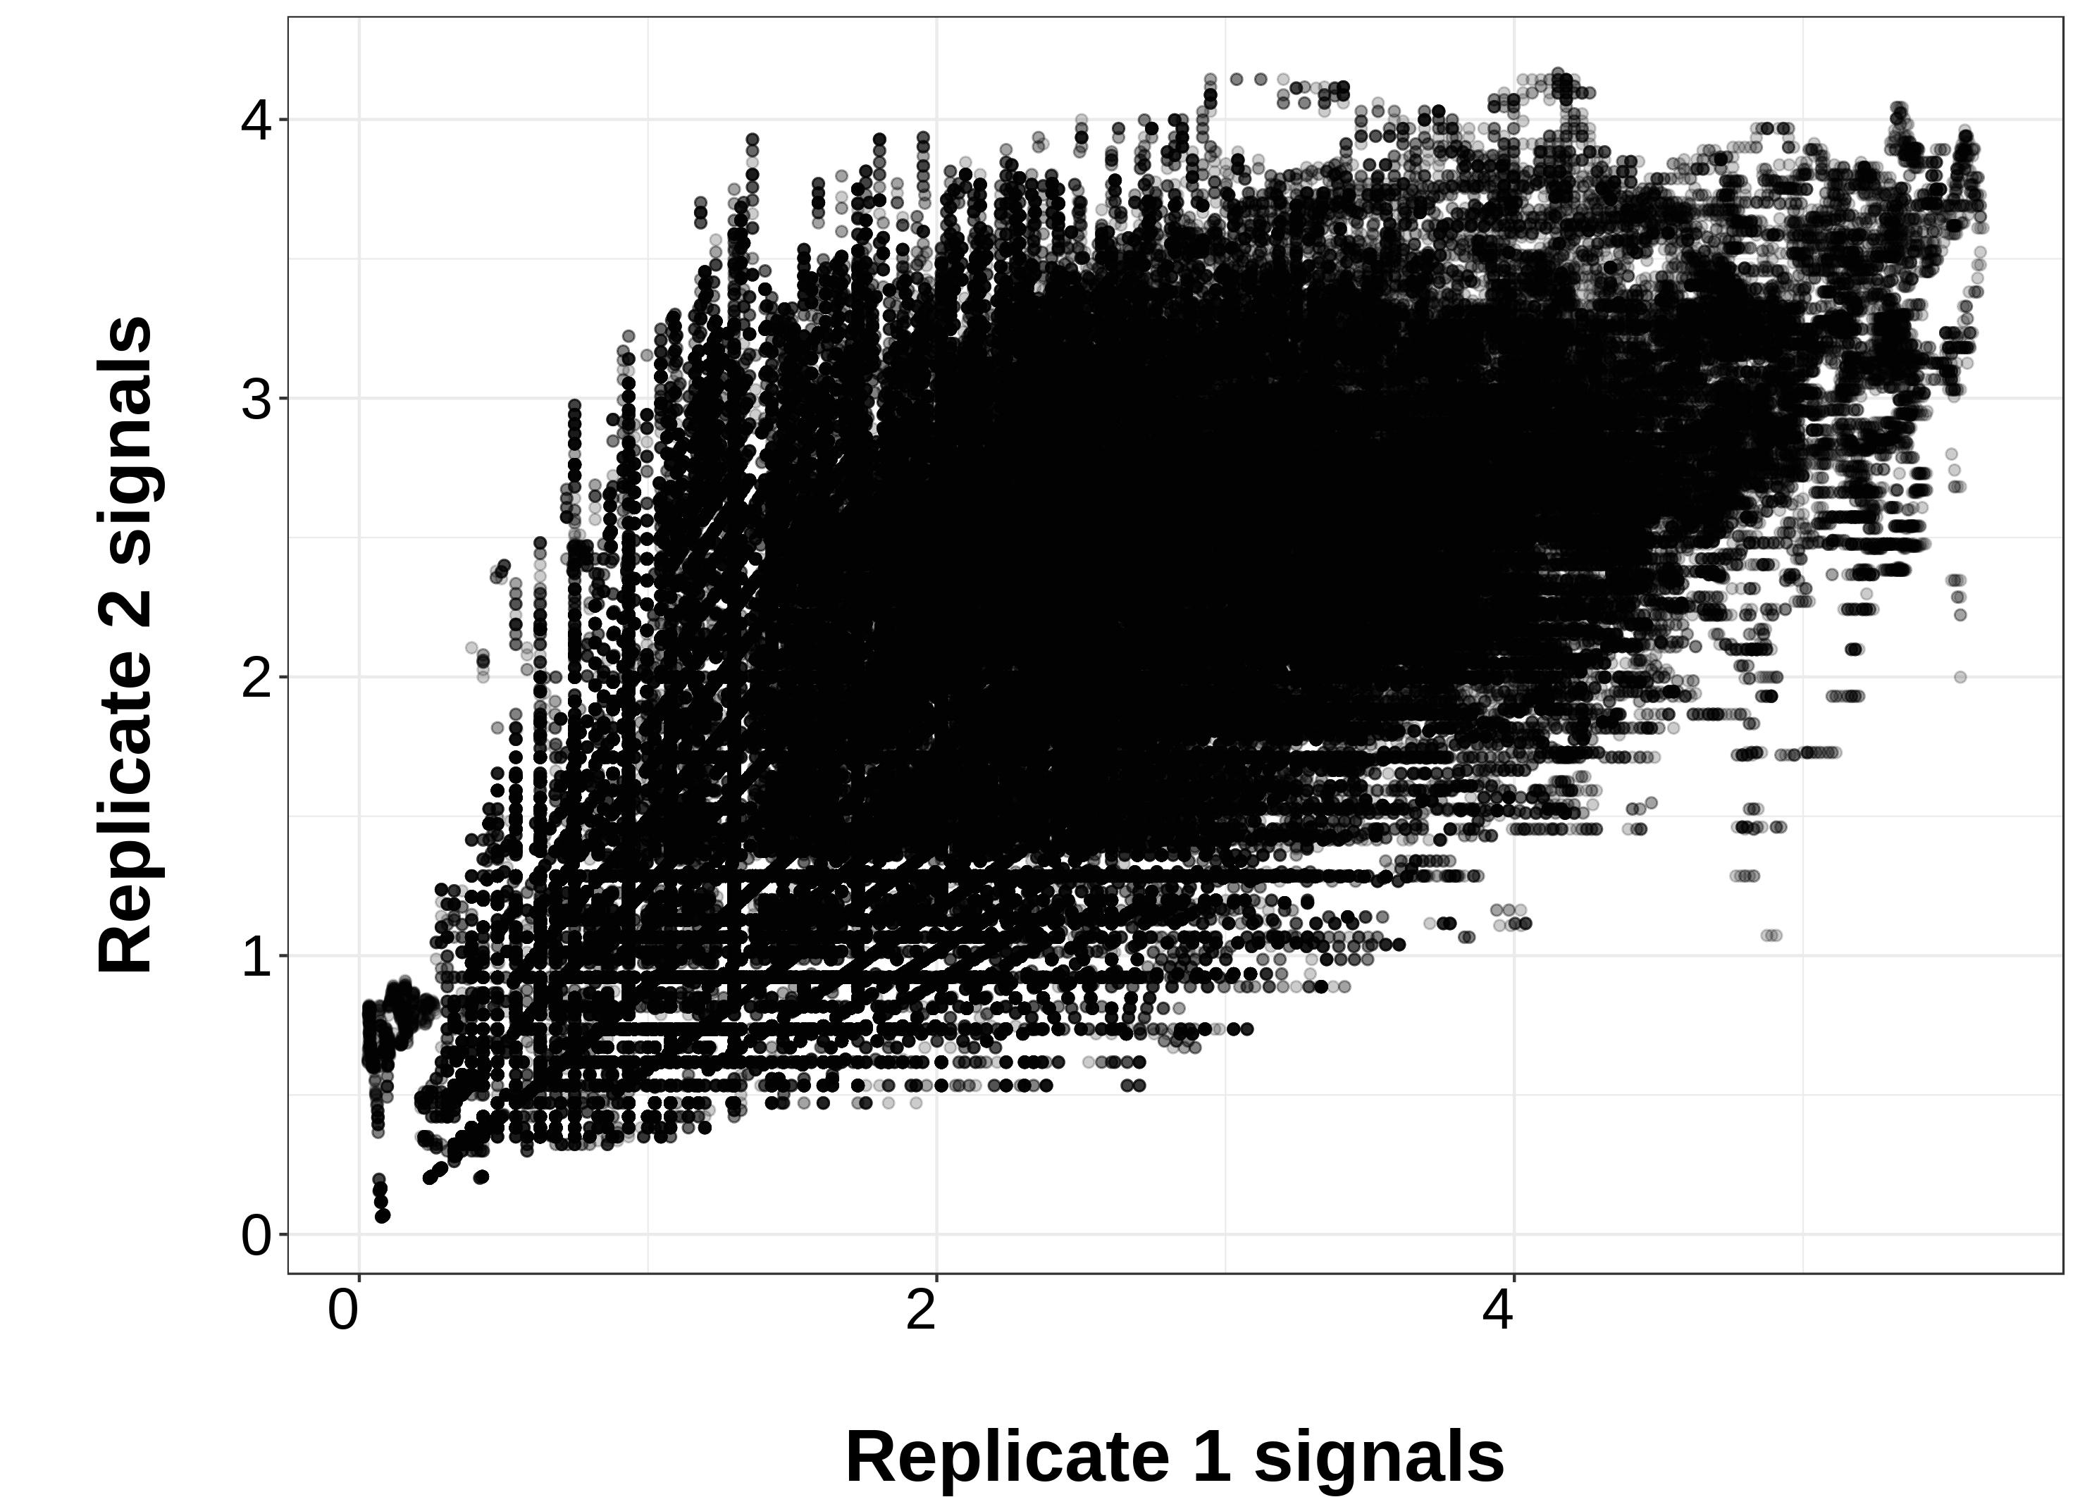
Notes:
H3K4me3 HUVEC_Fold_rep1_vs_rep2(all scores included)

Slide 6
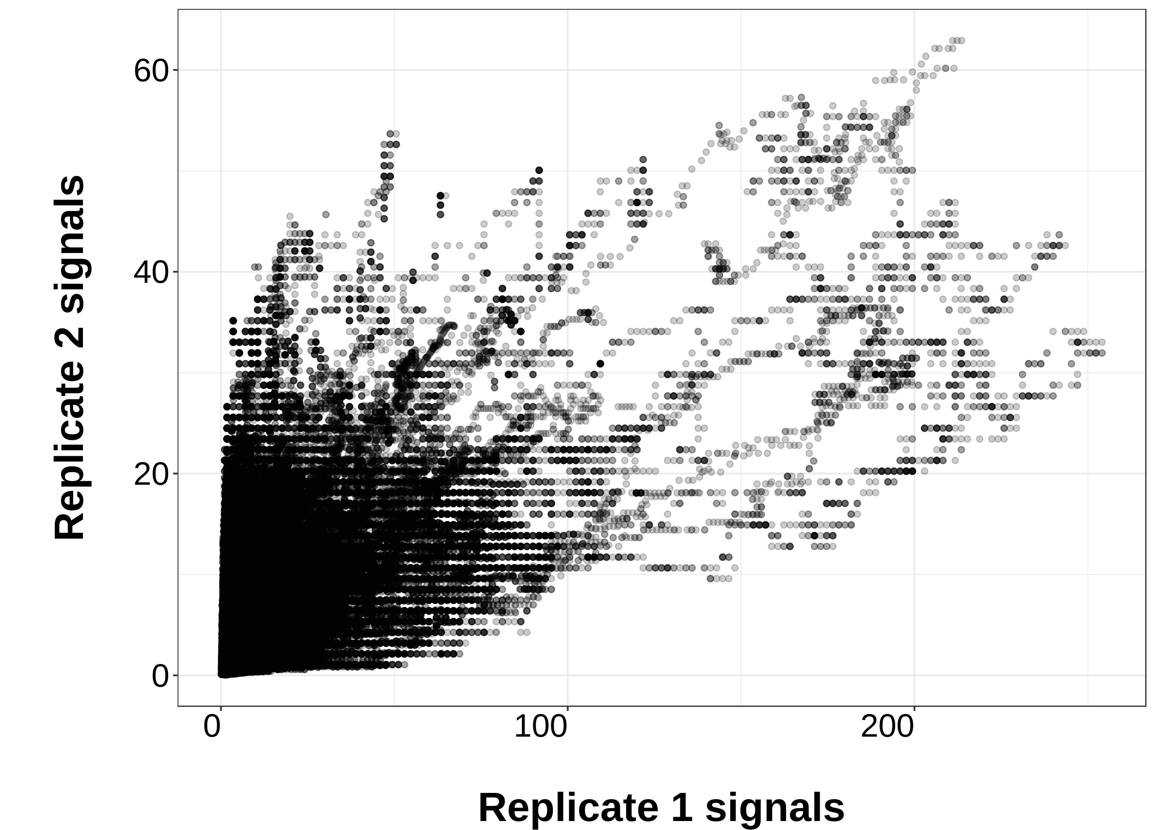
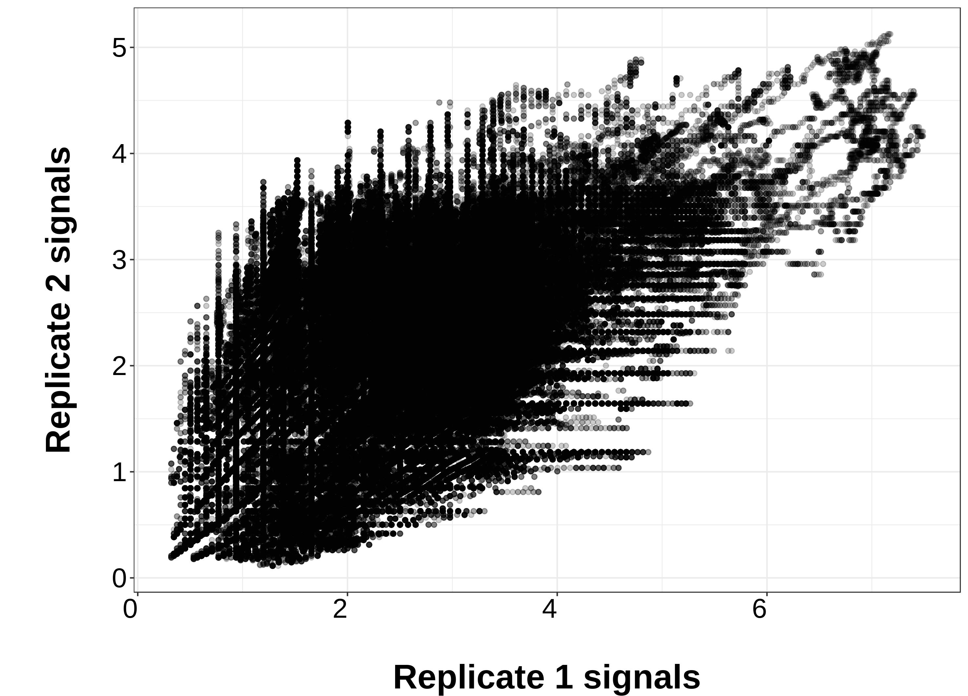
Notes:
H3K9me3 AG04450_Fold_rep1_vs_rep2(all scores included)

Slide 7
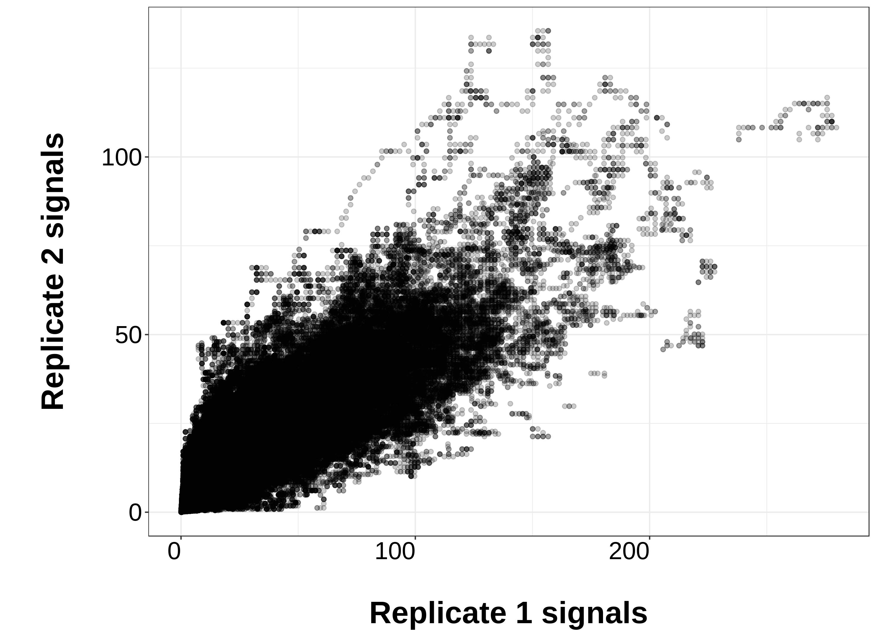
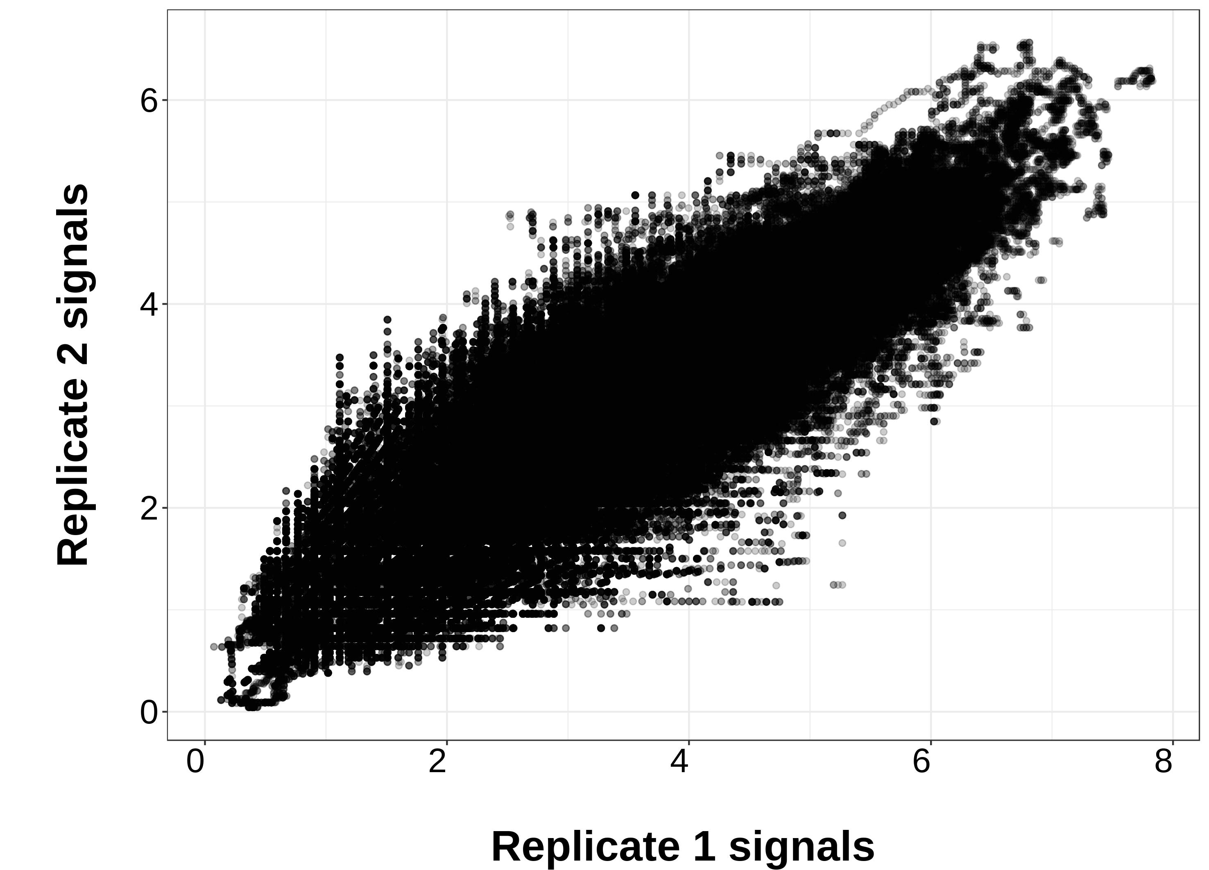
Y=x
Y=x
Notes:
H3K4me3 HSMM_Fold_rep1_vs_rep2(all scores included)

Slide 8
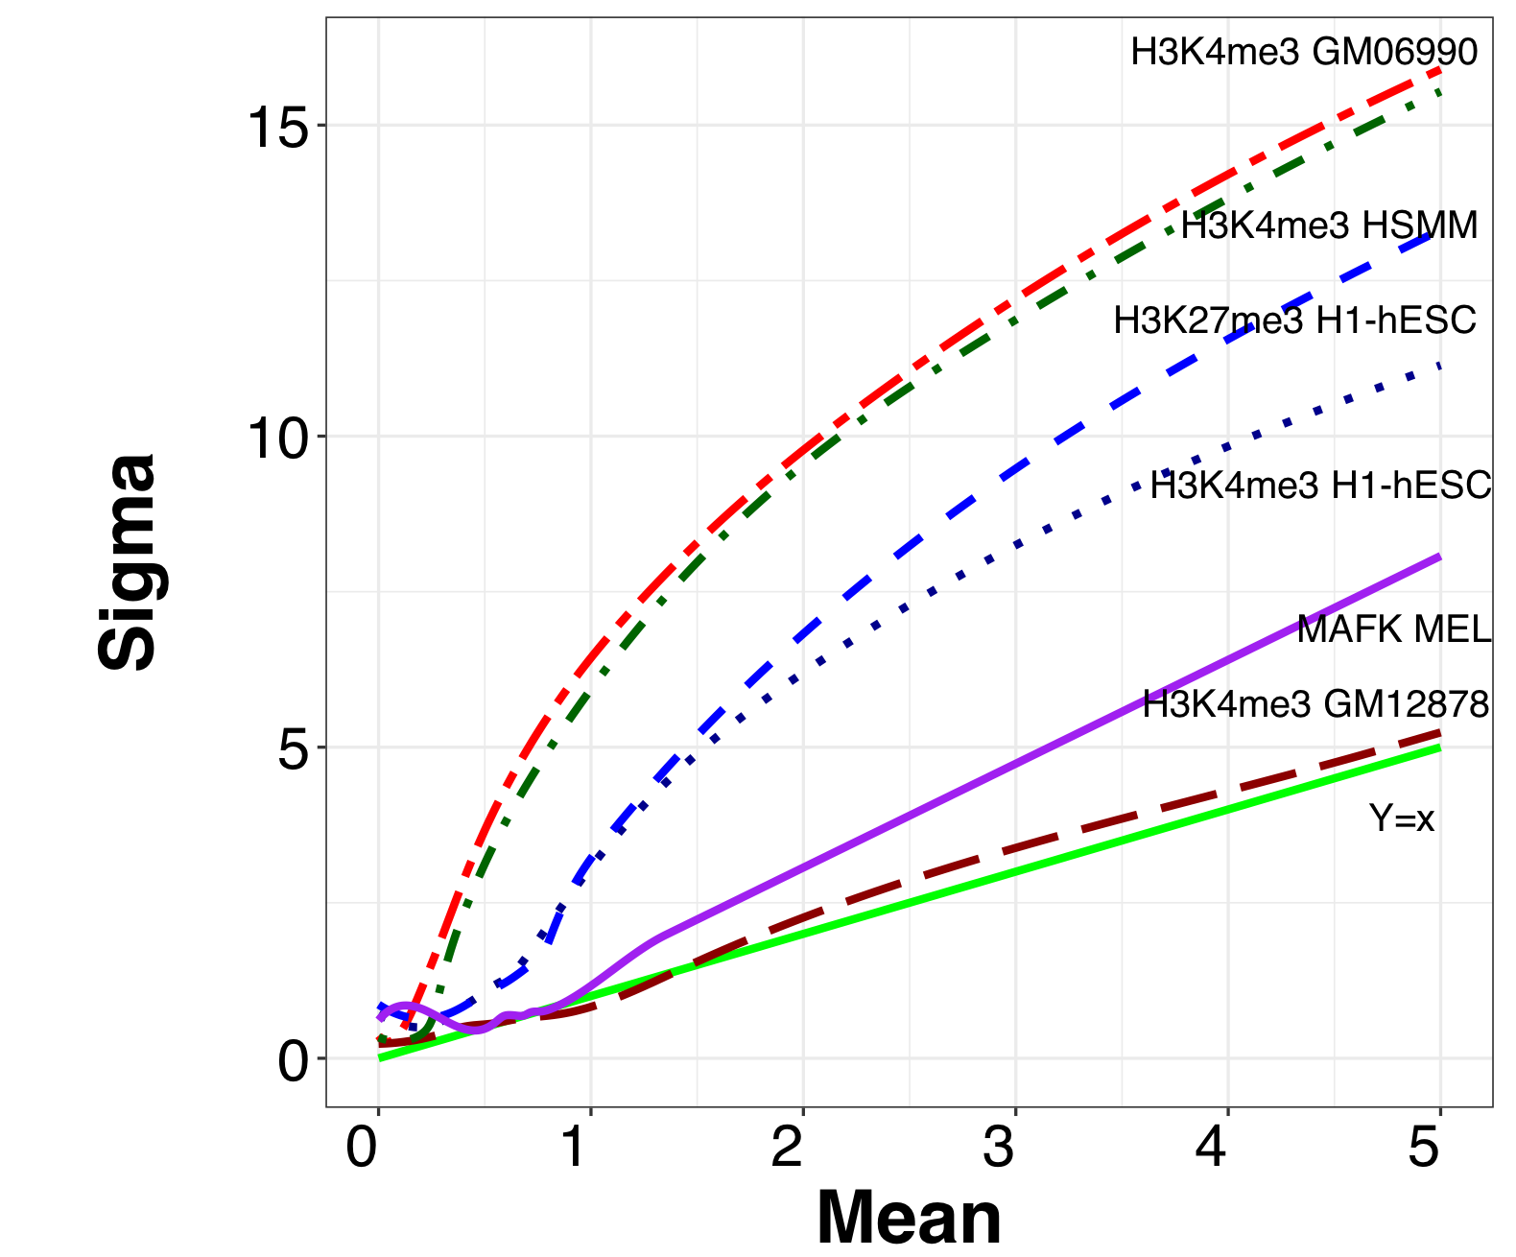
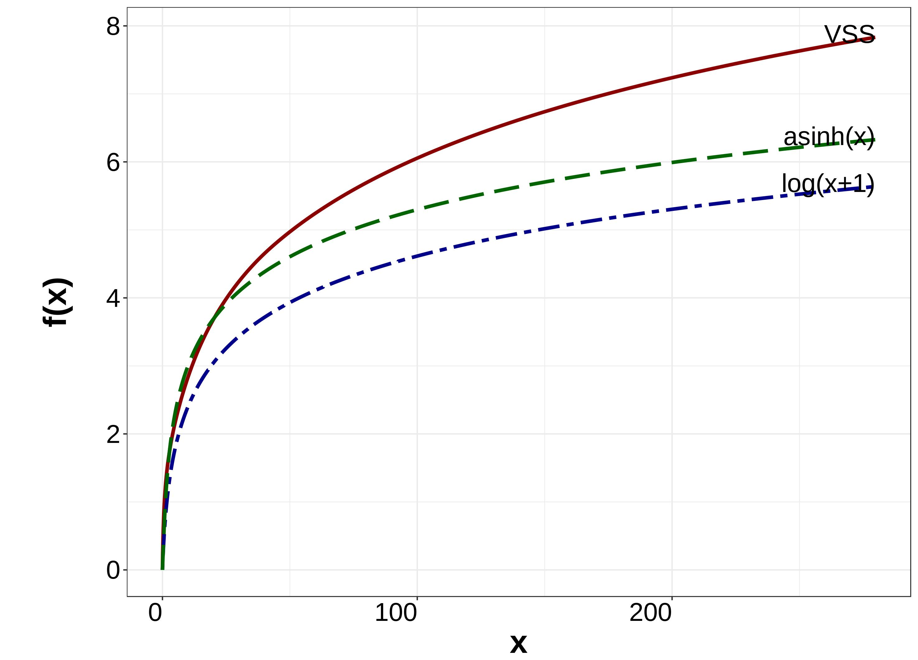
(a)
Y=x
(b)
Y=x
(c)
(d)
Sigma
Mean

Slide 9
(a)
(b)
b values
b values

Slide 10
H3K4me1 H1
H3K4me3 GM06990
H3K4me3 GM12878
b values
b values
b values
H3K4me3 HCPEpiC
H3K4me3 NHLF
H3K79me2 HMEC
b values
b values
b values

Slide 11
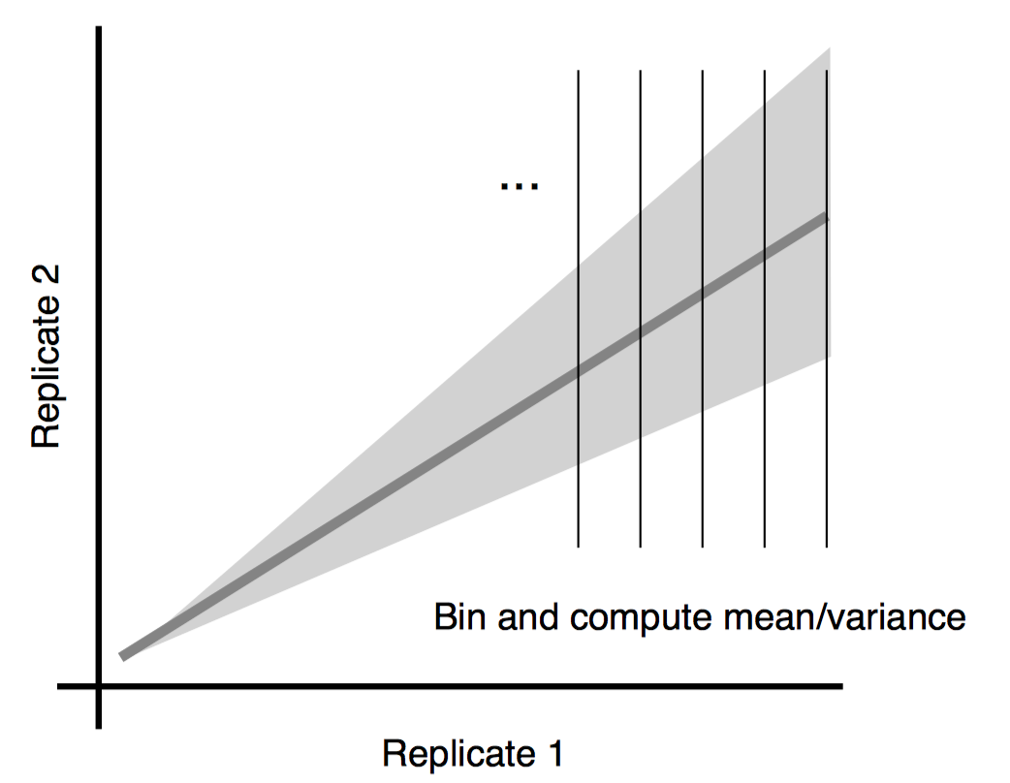
Base replicate
Auxiliary replicate
Replicate 1
Replicate 2
Auxiliary replicate
Replicate 2
Replicate 1
Base replicate

Slide 12
(a)
(b)
(c)
(d)
Notes:
Likelihood analysis figure

Slide 13
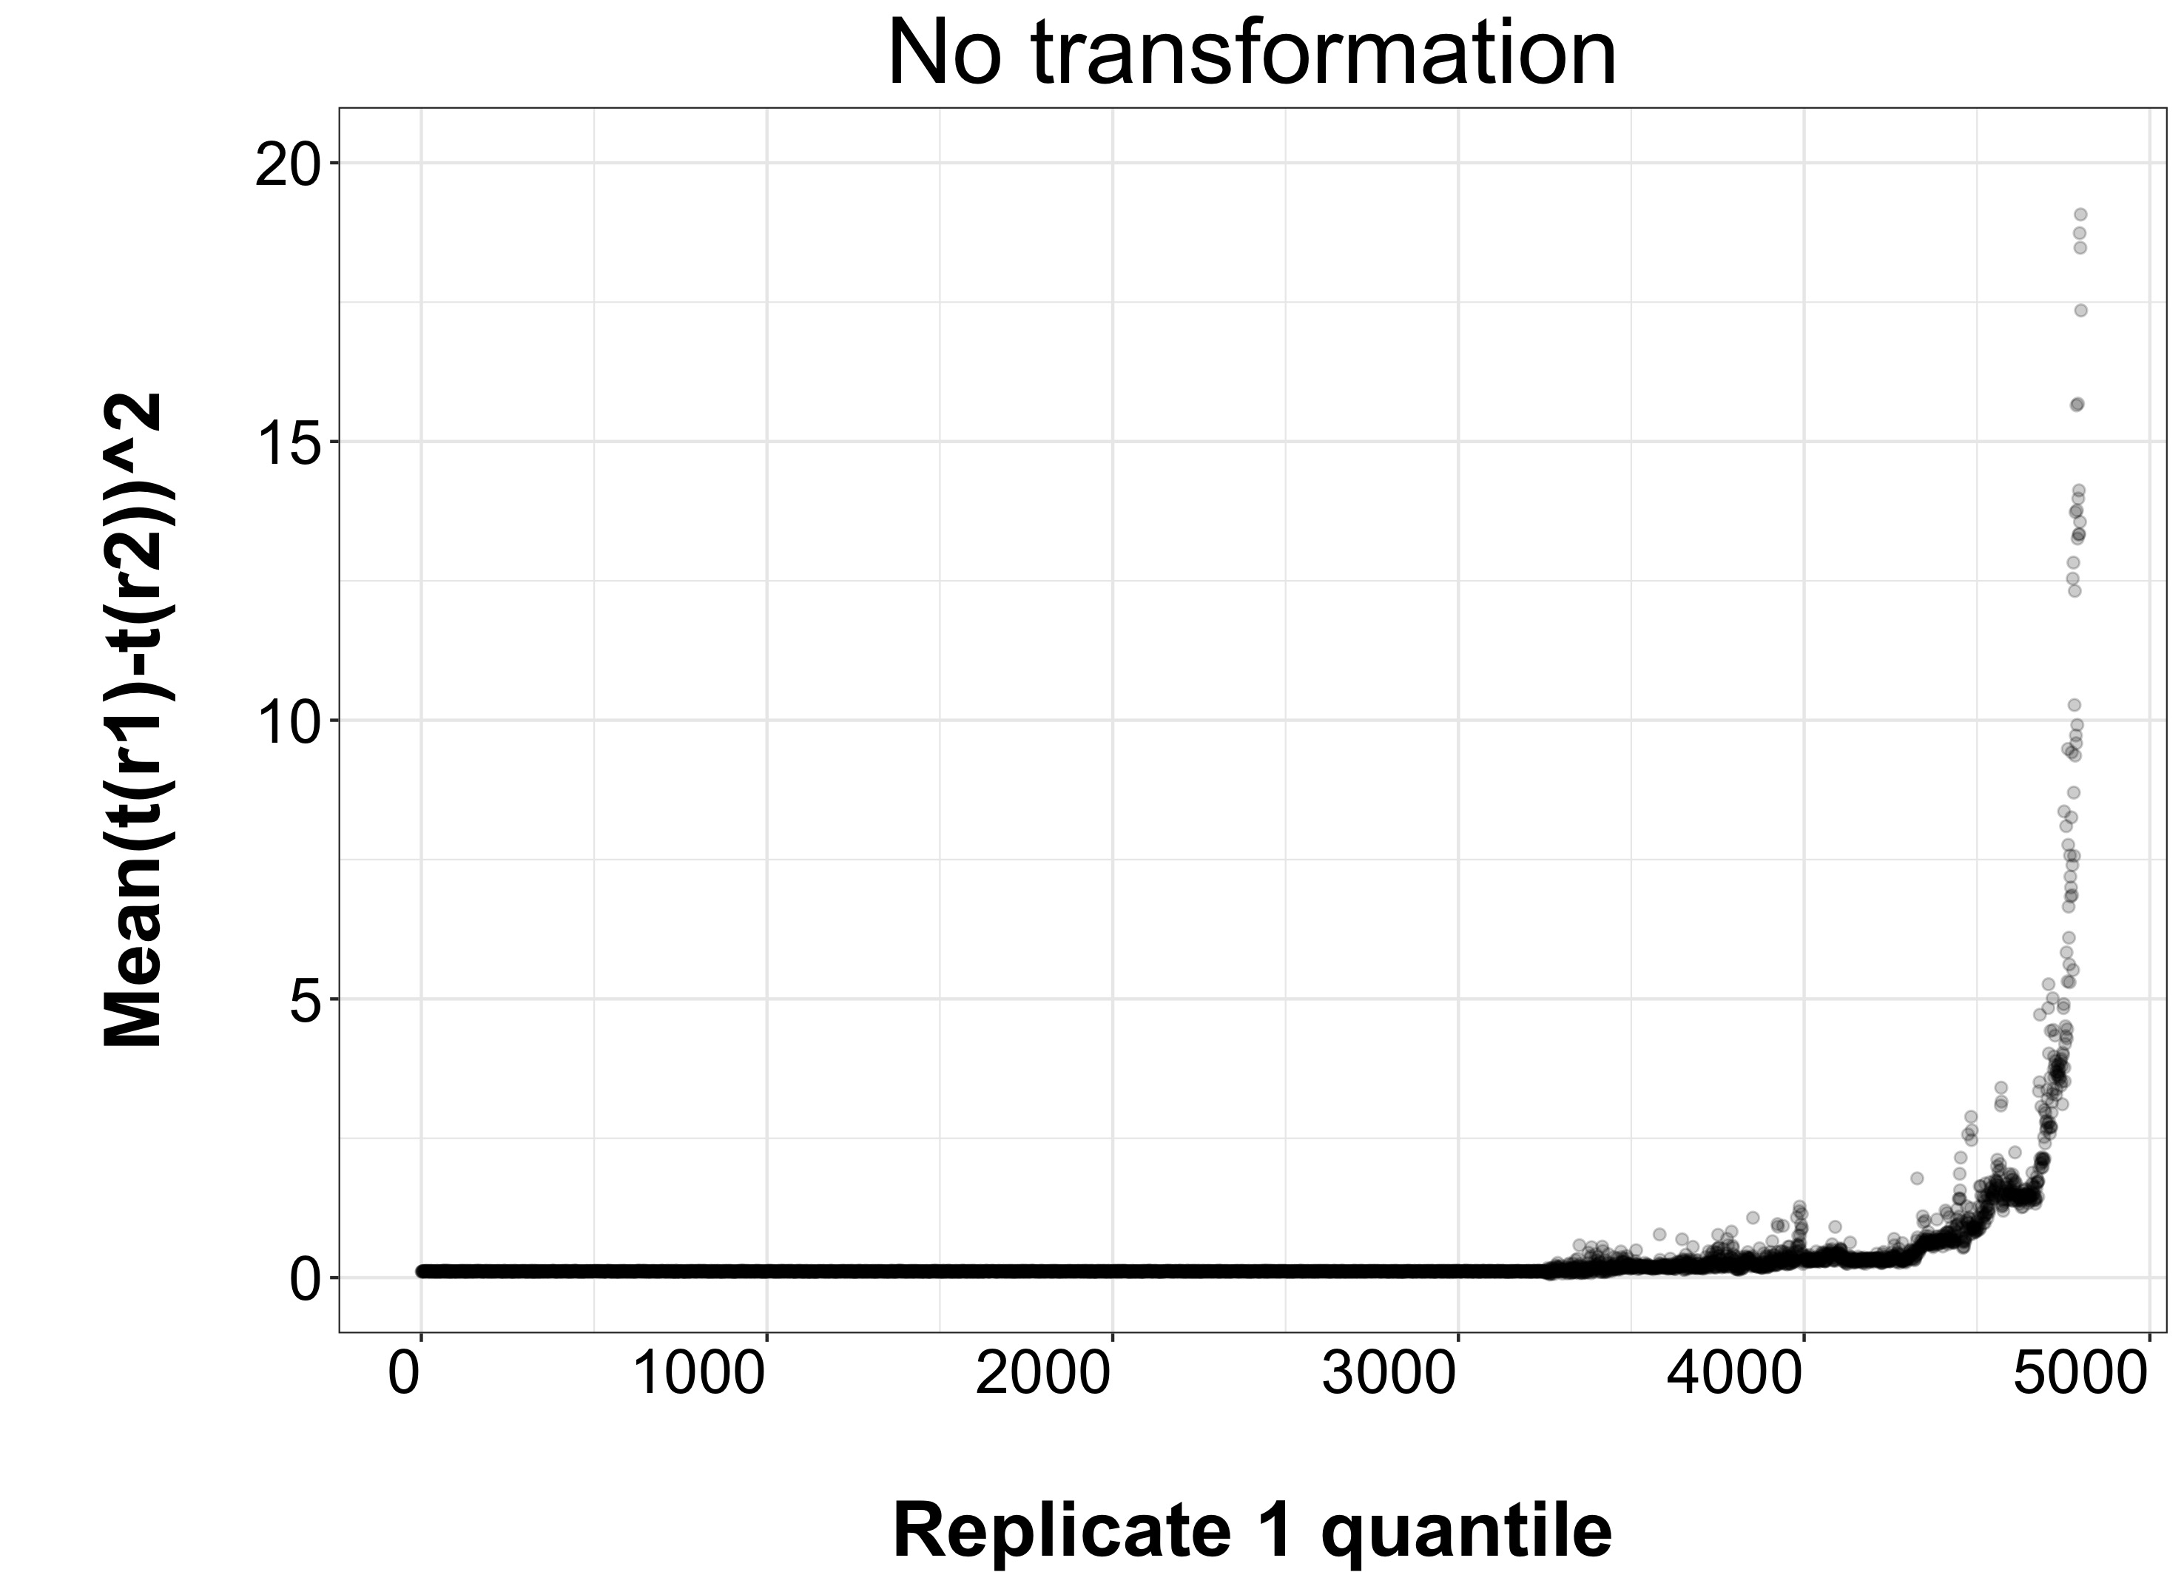
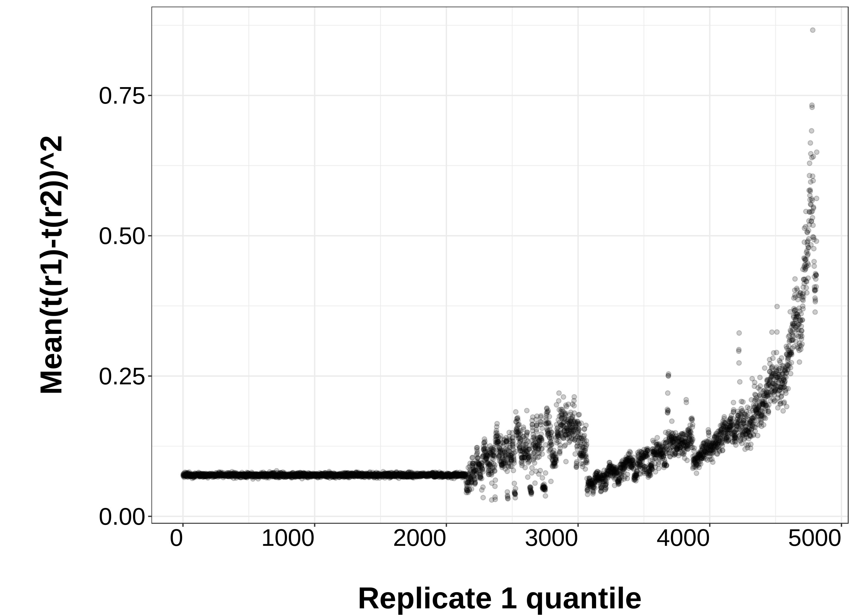
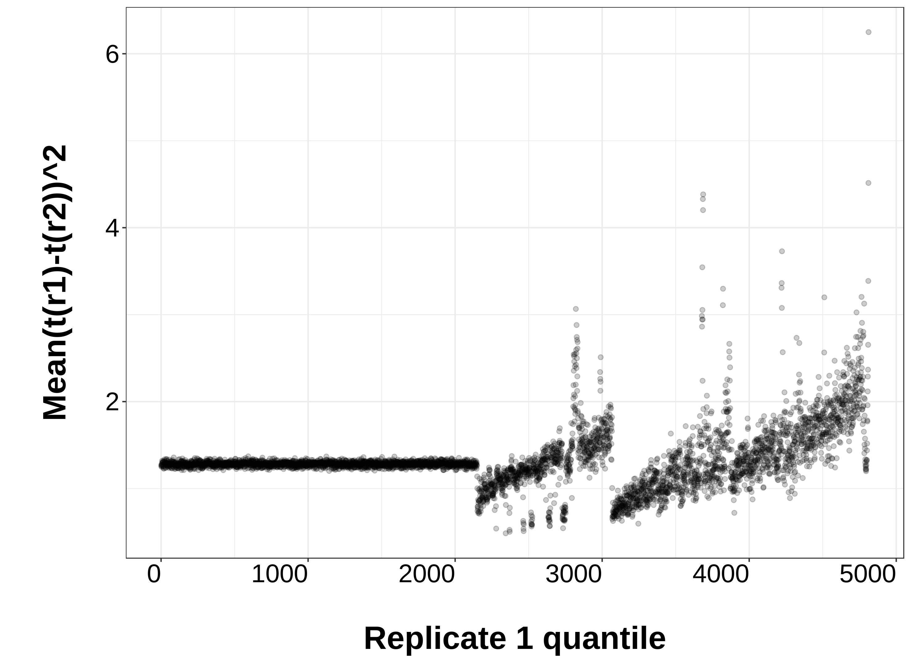
Log transformation
VSS
(a)
No transformation (FE)
(b)
(c)
X_{i}⁽¹⁾=0
X_{i}⁽¹⁾=0
(b)
(d)
(e)
(f)
(g)
Notes:
Variance instability figure

Slide 14
(a)
Base unit: Fold enrichment (FE)
(b)
Base unit: Raw signals (Raw)
0.023
<1.75e-06
<2.71e-05
0.053
0.28
0.028
(c)
Base unit: log Poisson p-value (LPPV)
0.0016
0.013
0.007
Notes:
Segway boxplot

Slide 15
(a)
(b)
(c)
Notes:
Segway lable vs r2

Slide 16
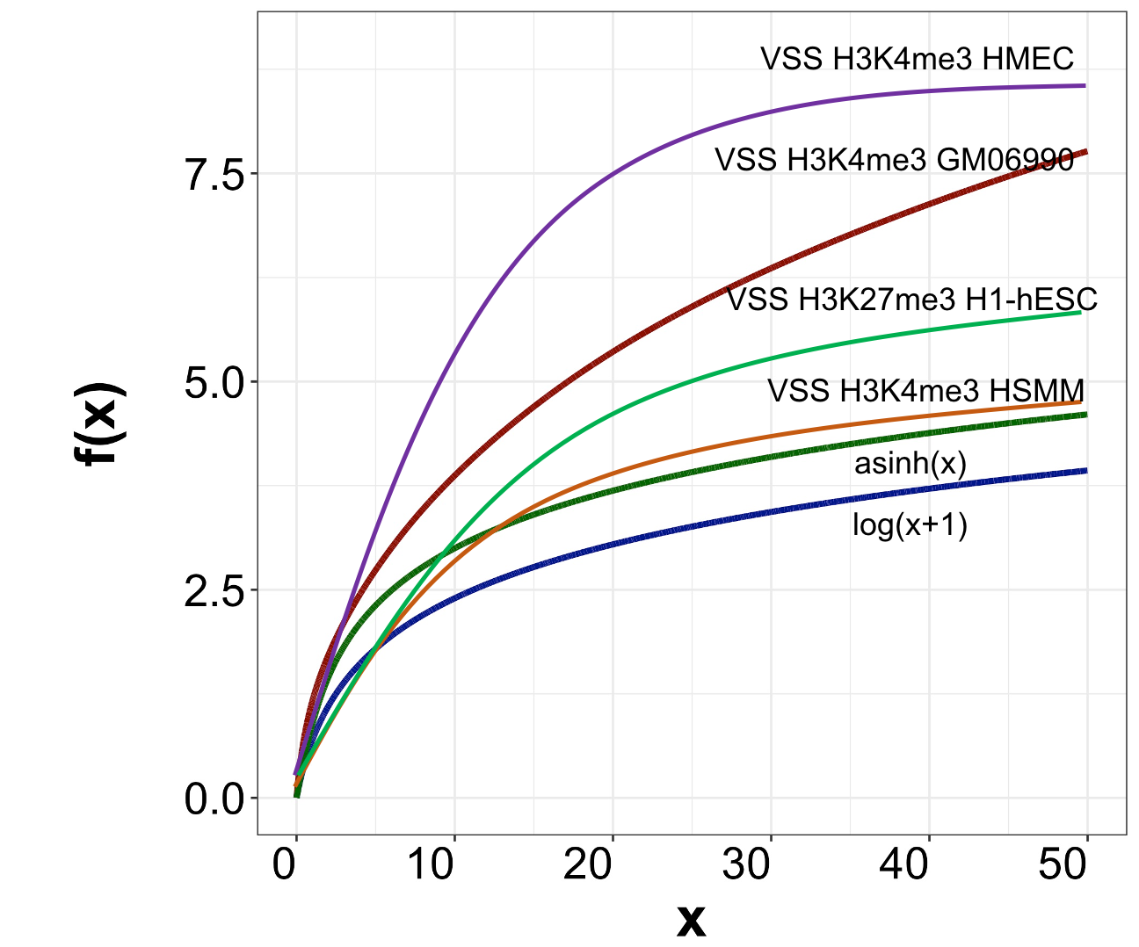
(a)
Base replicate Auxiliary replicate
(b)
Replicate 1
Replicate 2
Auxiliary replicate
Replicate 2
Replicate 1
Base replicate
(c)
(d)
(e)
(f)
Variance-instabilized signals (Untransformed)
Variance-stabilized signals (VSS)
Y=x
Y=x

